Slide 1
Role of the Architect
The emergence of the role of Software Architect

Slide 2
Roles circa 1990
Chief Programmer
Chief Analyst/Programmer
Senior Programmer
Programmer
Senior Staff Analyst/Programmer
Chief Systems Analyst
Senior Staff Systems Analyst
Systems Analyst
Senior Staff Programmer
Senior Analyst/Programmer
Senior Systems Analyst

Slide 3
Narrow Range of Technologies
Programmer
Analyst
COBOL, PL/1, Assembler
DB2/SQL/CICS
LSDM (Methodology)
Entity Modelling

Slide 4
Shift to a greater set of Technologies
Programmer
Analyst
Visual Basic
Visual C++ & MFC
UI Design (Windows)
ODBC
T-SQL & SQL-Server
Client/Server
UML
OO Analysis
OO Design
Prototyping & Rapid Application Development (RAD)

Slide 5
Shifting from C to C++
C
C++
Macros
Pointers
Structs
Arrays
Typedefs
Functions
Macros
Pointers
Structs
Arrays
Typedefs
Functions
Classes
Inheritance
Private & Protected Members
Namespace
Function Overloading
Constructors
Destructors
Default Params
Inline Functions
References
Const
Friends
Templates
Exceptions

Slide 6
Technology Shifts in early ‘90s
Object Oriented Programming
Lead to a mix of analysis & design
Combining function and data – forced to think about design
OOP facilitated/encouraged more complex design, leading to more complicated applications
WIMP & WYSIWYG
Windows, Icons, Mouse & Pointers
Vastly richer UI – and hence more complicated
PCs & Networks
Client/Server - involved the network
Concurrency Control

Slide 7
The Result?
Greater level of Complexity
Increased Levels of Abstraction
Drive for re-use – the promise of OO
Need for increased degree of System Oversight

Slide 8
Emergence of the Architect
Focus on the high-level design choices – i.e. The ‘Big Picture’.
Chose technologies/technology stacks & understand their interaction → Consistency
Determine the projects technical ‘philosophy’ & control/limit Design Choices
Define the ‘component model’ – i.e. high-level object model
Design for Re-use; Design for change; Design for extensibility (insulating layers)
Determine Coding Standards
Communicate these concepts to the developers/engineering teams

Slide 9
Types of Architect
Role | Description
Solutions Architect* | Typically focused on a BU Concerned with interaction between applications Plugging systems together to form a solution Communicates with several teams
Application/Technical Architect | Focused on application development – i.e. product Concerned with internal design, component reuse, code quality, maintainability & extensibility Communicates across the engineering team Often a strong developer/engineer
Embedded Systems Architect | Very focused on the hardware & embedded system Concerned with embedded system internals Communicates within team & interacts with Application/Solution Architect.
Enterprise Architect | Interaction between BUs and IT Business Transformation Scope is across the organization Highly abstracted design Communicates across the organization

Slide 10
Challenges – Not recognizing the politics of architecture
Architecture is a political act
Engineers like to believe they are outside politics
They are not – where you have humans, you have politics
The architect is the most prestigious role in software development
Dangerous assumptions:
All developers have honest intentions with regard to the project
We want to believe the best course of action is the obvious one (and everyone will agree)
No one likes confrontation
^arguably
Pitfalls of Object-Oriented Development by Bruce Webster

Slide 11
Architect Needs
Authority
Authority commensurate with Responsibility
Authority to compel adherence
Upper Management Support
Full backing of management hierarchy
Proven Track Record
Pact with Engineers that serious consideration will be given to all ideas & suggestions
Willingness to give ground on smaller design issues to ensure integrity of the bigger, more important design decisions

Slide 12
Challenges – Don’t expect thanks
Much of Software Architecture is invisible
Generally, no one says ‘good job’ for ‘*ilities’:
Scalability (+ Performance)
Recoverability
Extensibility
Adaptability
Performance
Robustness

Slide 13
Skills
Skills Required of the Architect
Hard Technical Skills
Fuzzier Analysis & Design Skills
Soft skills
Perspective
Set the vision
Ability to zoom out and see the ‘bigger picture’
Ability to zoom in to the lowest detail*
Communication
Deal with engineering management & upper management
Might deal with C-level executives, like CTO
Communicate to all levels of engineering
Communicate with DevOps
*Controversial

Slide 14


Slide 15
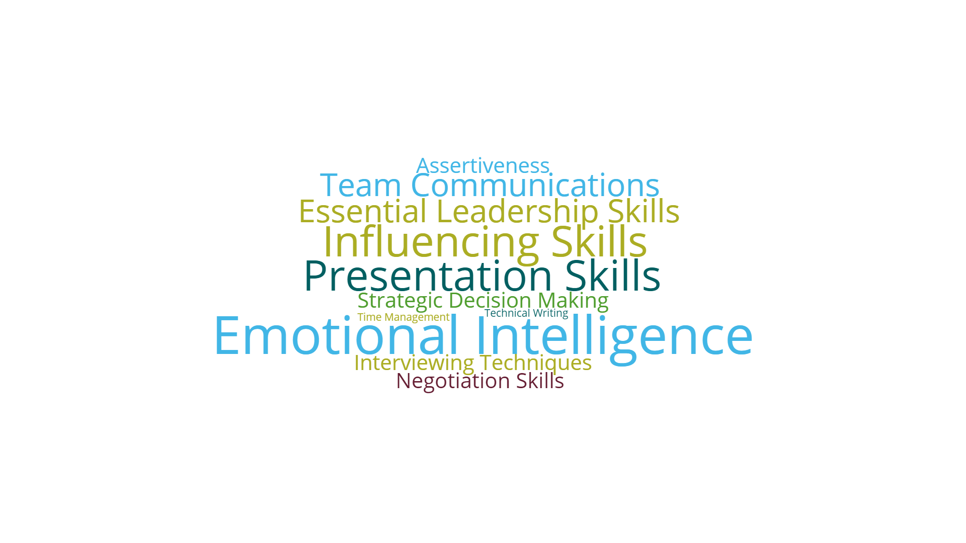

Slide 16
Q&A
Discussion Time

Slide 17
Summary
Role of Architect is now firmly established
Complexity of modern software development means someone (or some team) needs to manage the ‘Big Picture’
Can mean different roles, depending on organization - There are different types of architect.
Challenging Role – Need to be a master of the ‘soft skills’
Needs Upper Management Support – Needs a degree of Authority

Slide 18
Recommended Reading
https://www.sei.cmu.edu/architecture/research/previousresearch/duties.cfm
https://resources.sei.cmu.edu/library/results.cfm#stq=software%20architect&stp=1
http://www.codingthearchitecture.com/presentations/dw2009-pitfalls-for-new-software-architects/

